Slide 1
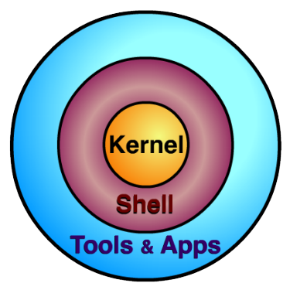
UNIX
The Basics
Source: http://cis.kutztown.edu/~kta/Projects/Unix.ppt

Slide 2
What is Unix?
Unix is just an operating system. It provides the same functionality as the operating systems we all know and love.
What makes Unix slightly more challenging, is it’s lack of the clickable graphical user interface we are all so accustomed to.
Don’t worry, it’s really not as difficult as it may seem at first! You’ll be a Unix expert in no time.

Slide 3
File System Structure
To start out, you need to have an understanding of how Unix arranges it’s files. So let’s call the file system a tree.
Think about hanging the tree upside down. All branches (directories) come from the trunk (root), or from other branches (directories).
So if the branches are file folders (directories), then the leaves must be the files contained in the directories!

Slide 4
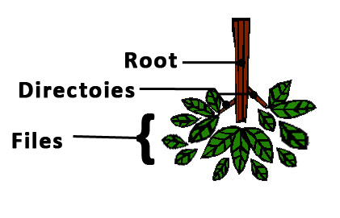
File System Structure
The trunk is the root directory.
Branches are directories.
Leaves are files.

Slide 5
File System Structure
So does the file system structure of Unix look similar to another operating system?
It should! It’s very similar to any windows, mac, or linux operating system!
  A path to a file from the root could look something like this: /dirlvl1/dirlvl2/my_file
So you should already know how things work. You just need to know the Unix commands to get around!
Note that Unix uses the forward slash! (Opposite of windows)

Slide 6
Basic Unix Commands (1)
Man – Displays a manual for any command
  “man pwd” will give you the manual for the pwd command.
Pwd – Displays the present working directory
  “pwd” after login will show the location of your home directory.
Ls – Lists the contents of your present directory
  “ls” after login will show you all the files and directories in your home directory.

Slide 7
Basic Unix Commands (2)
Cd – Change the working directory (the working directory is just the one you are in)
  “cd mydir” from the home directory will take you to mydir provided it exists in the home directory.
  “cd” by itself will take you to your home directory.
  FYI: There are two symbols that mean current directory and parent directory respectively.
    ./ means current directory (“cd ./” takes you nowhere)
    ../ means parent directory (“cd ../” will take you to the directory containing the one you are in)

Slide 8
Basic Unix Commands (3)
Mkdir – Make a directory
  “mkdir mydir” will make a directory named mydir inside the current working directory.
Mvdir – Move a directory
  “mvdir mydir1 mydir2” will move mydir1 inside of mydir 2 provided mydir2 exists. If not, mydir1 will be renamed mydir2!
Rmdir – Remove a directory
  “rmdir mydir” will remove mydir (if empty)

Slide 9
Basic Unix Commands(4)
Mv – Move a file
  “mv myfile ../” will move myfile to the parent directory of the current directory.
Rm – Remove a file
  “rm myfile” will delete myfile.
Cp – Copy a file (Adding -r copies a directory)
  “cp myfile someplace” will copy myfile to the directory someplace if it exists. Otherwise, it will make a duplicate copy of myfile called someplace.

Slide 10
Unix Commands (5)
Clear – clears the screen
  “clear” will give you a blank screen. You can still scroll up to see your text again in putty.
Cat – displays a file (all at once)
  “cat myfile” will print out myfile to the screen.
Page – displays a file (line by line)
  “page myfile” will print out myfile line by line
Exit – exits Unix
  “exit” will log you out and close putty.

Slide 11
Script and Typescript
The script command begins saving all text you type. It comes in very useful to save input and output to and from Unix.
  To begin issue the “script”command.
  Do whatever you want.
  To end, use ctrl + d.
When done, script will save all input and output to a file named typescript.

Slide 12
Caution with Script & Typescript
If you already have a file named typescript in your current directory, the script command will overwrite it without asking you!
You can use the script command with a name to choose the file the input/output from the terminal is sent to in order to avoid this.
  “script myscript” will save everything to a file named myscript instead of the regular typescript.

Slide 13
Printing
Printers – displays a list of available printers
  “printers” will show all printers on campus.
Lp – prints a file to a campus printer
  “lp -d Grim_Lab myfile” will print myfile to the grim lab printer.
  Printer names are case sensitive, and the -d is required to tell lp which printer to use.
  Currently there is no default printer, so executing “lp myfile” wouldn’t do anything.

Slide 14
Printing Locally
To print to a local printer, you must first set up putty to use your local printer. (The option is located under Terminal in the putty configuration window.
Ansiprint – prints to the local printer
  “ansiprint myfile” will print myfile on the local printer (which is pre-specified in putty). If no printer is set up in putty’s settings, it will not work.

Slide 15
Text Editors
So you want to make a new file? First you are going to need to choose a text editor. It may be a difficult decision, but we are here to help.
Some determining factors:
  What text editor is your professor using?
  Are you a computer science major or not?
  How much functionality do you want?
  After the initial learning curve, how fast do you want to be able to edit?

Slide 16
Pico
Pico is by far the easiest text editor to learn. It’s like a non-graphical version of notepad.
The downside:
  Not every Unix machine has Pico installed.
  You can edit faster in other text editors after you’ve learned them well enough.
  Computer science majors who use Pico tend to be made fun of. (Just kidding)

Slide 17
Pico Basics
Open a file using “pico the_file”.
Move around just like you are in notepad.
Edit and delete using the normal keys.
Save using CTRL + O
Exit using CTRL + X
Go to a specific line number using CTRL + W, CTRL + T, and the number

Slide 18
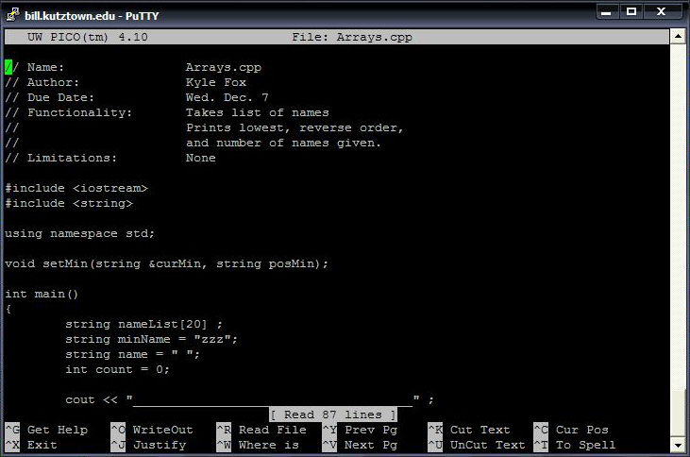
Pico Image

Slide 19
Vi
Vi is a feature rich editor located on almost all Unix machines around. Once learned, editing files is extremely fast.
The downside:
  It’s more complicated than Pico.
  It takes time to learn how to use vi.
  It’s easy to mess up your documents when you are first learning vi.

Slide 20
Vi Basics (1)
There are three modes to vi:
  Command mode (you start in this mode)
    It is used for entering commands
    The escape key always gets you back to command
  Insert/Append mode
    It is used for inserting or appending text
    From command mode, “a” will get you append mode, and “i” will get you insert mode.
  Line mode
    The “:” from command will get you to line mode.
    It is used for controls like saving and exiting.

Slide 21
Vi Basics (2)
Open a file using “vi the_file”.
Save using “w” (write) from line mode.
Quit using “q” (quit) from line mode.
Combine the two to save and quit “wq”.
Go to line using “#a_number” from line mode.
Delete a character using “x” from control mode.
Delete a line using “dd” from control mode.

Slide 22
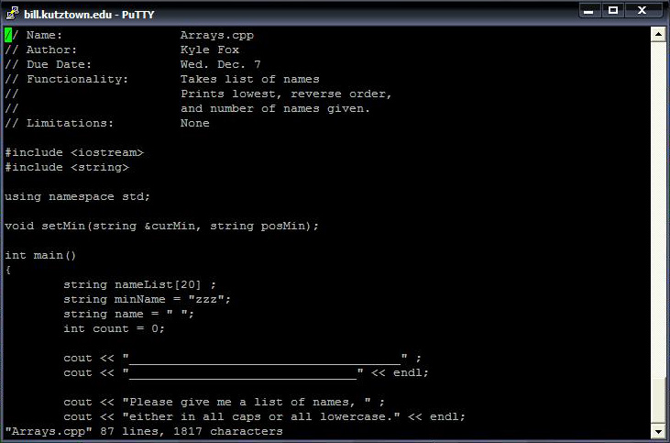
Vi Image

Slide 23
Emacs
Emacs is an extendable, customizable, versatile editor capable of doing much more than a regular editor.
It is able to be integrated with GDB, the debugger used for C++.
The downside:
  It is more complicated than Pico
  It’s going to take time to learn how to get around.

Slide 24
Emacs Basics(1)
Open a file using “emacs the_file”.
  Note: once emacs opens, you will need to use ctrl-l to move to the file you are editing.
Save a file using ctrl-x, ctrl-s
Exit using ctrl-x, ctrl-c
Go to line using alt+g, g
Stop emacs by using ctrl-g

Slide 25
Compiling a C++ Program
To compile a c++ program, use the g++ command. “g++ myprogram.cpp”
  Provided there are no errors, this will create an executable file called a.out.
  If you want to name your executable file, use the -o flag to specify a name. “g++ myprogram.cpp -o myprogram.out”

Slide 26
Running a C++ Program
Running a c++ program is easy, just type in the name of the executable file!
  “a.out”
There could be a minor issue however. If for some reason, that doesn’t work, try preceding the name with a ./
  “./a.out”

Slide 27
Break!
Let’s say you run your program, and realize it never stops! You are stuck in an infinite loop. You need a way to stop (or break) your program.
Use ctrl-c to stop a program running in an infinite loop

Slide 28
Core Files
If for some reason, you have a very bad error happen when you run your program, you may end up with a core dump.
What happens is that Unix saves all information about what happened to a file named “core”.
Make sure if this happens to you, that you remove the core file, because they are big, and can take up a lot of your space!

Slide 29
Wildcard
In Unix, there exists a wildcard character. It is the asterix(*).
Basically, wherever you put an asterix, Unix will try to put any character or word. So something like “*.cpp” will select every single .cpp file in your directory.
Careful! It can be handy, but dangerous! Using “rm *” would remove everything!

Slide 30
That’s It!
Good luck to everyone!

